Slide 1
AirKitchen:
Week8 Update
Team FoodXYZ
Mengdan Yuan, Wen Xin

Slide 2

https://img.huffingtonpost.com/asset/585be1aa1600002400bdf2a6.jpeg?ops=scalefit_970_noupscale

Slide 3
Feature Engineering
Add dummy variable to indicate if it’s NA; then fill in the NA
Add 5 principle components as new features
Change coupon worth total to coupon worth avg and max
Log transform
Convert categorical variables into binary variables

Slide 4
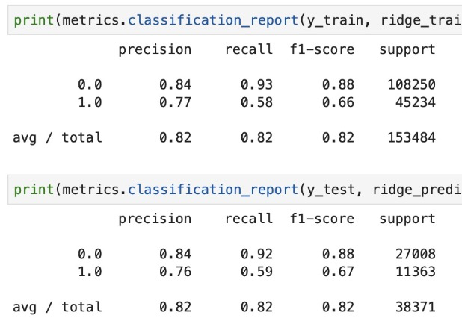
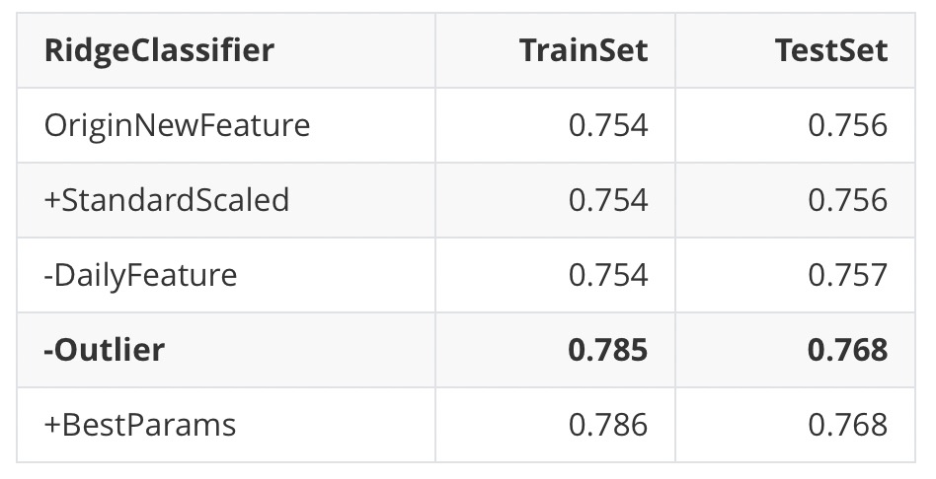
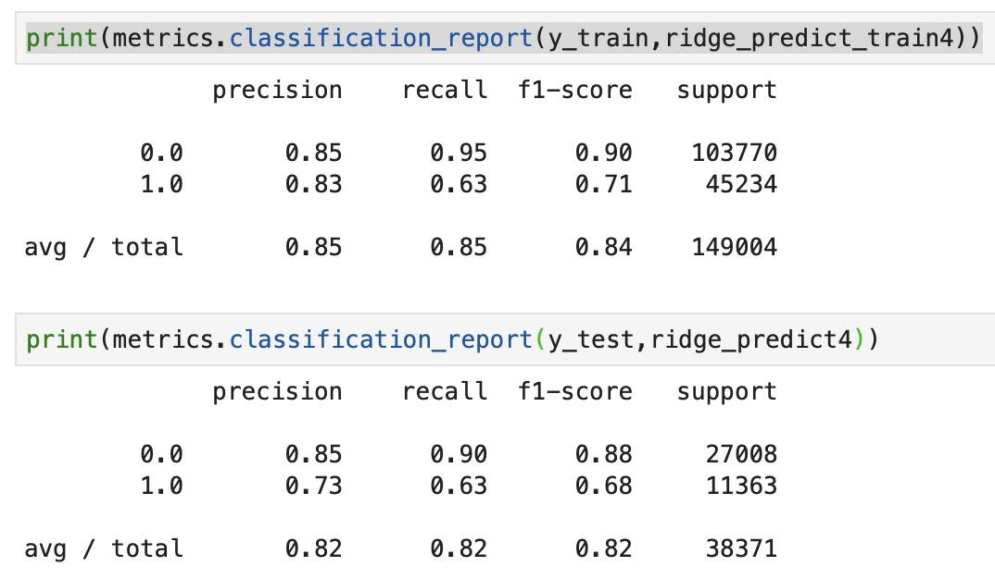
Models 1
RidgeClassifier
Metric: ROC_AUC_SCORE
origin
-outlier
Recall improves a lot, although precision decreases (also cause a little overfitting)

Slide 5
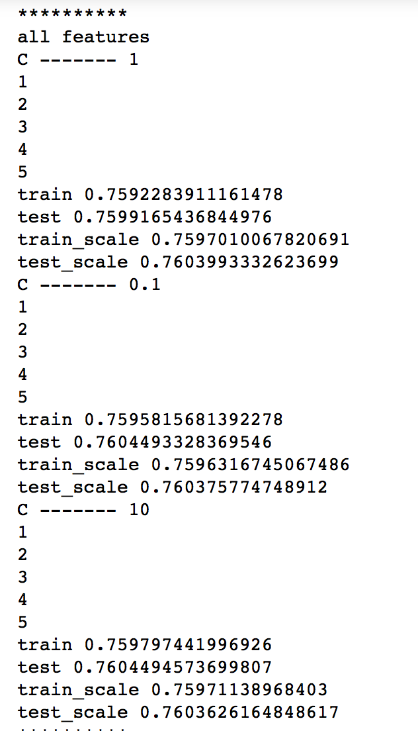
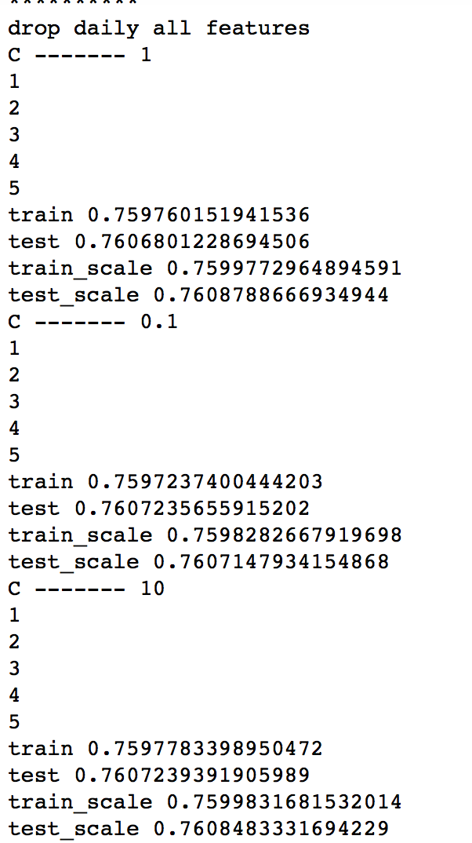
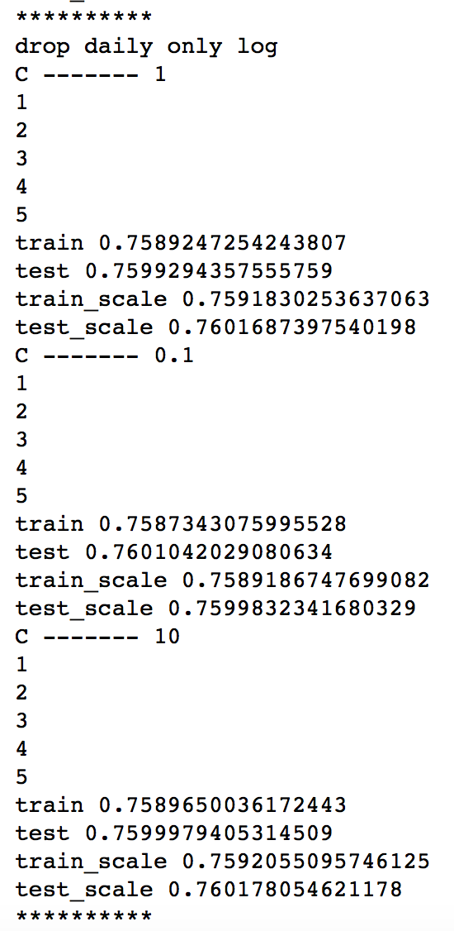
Models 2
LogisticRegression
Metric: ROC_AUC_SCORE

Slide 6
Next Steps
Undersampling / oversampling
Move to non linear models

